Slide 1

MINI PROJECT 01
26 Jul 2021
Nadun Basnayake

Slide 2
Business Question
What makes a country happy?
Is there a relationship between better distribution of income, healthcare facilities, education, AND happiness?

Slide 3
Importance of the Question
Helps us question current measurements and encourages us to find more ways of making lives better.
Helps policy makers and people focus on what really matters to improve the lives of people.

Slide 4
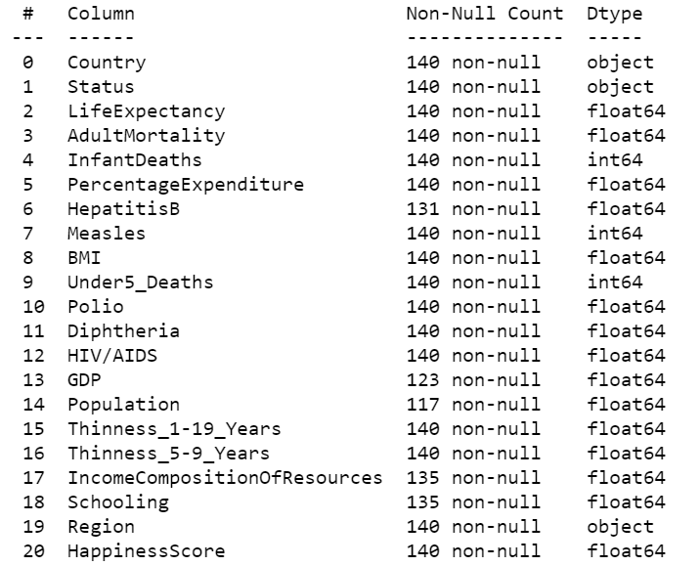
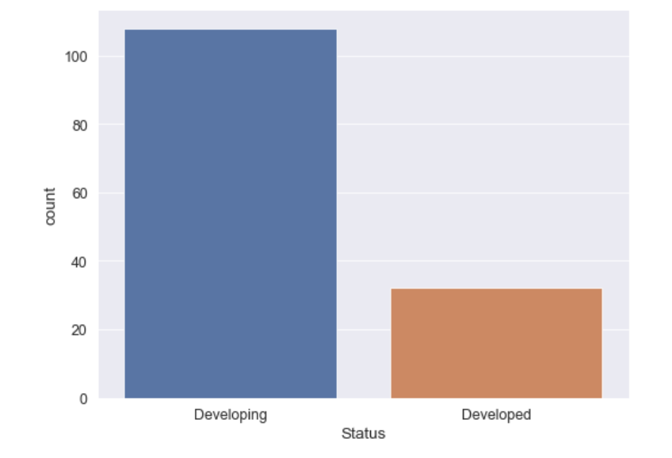
Dataset Summary
Dataset 1 – World Happiness Report (2 Features) - https://worldhappiness.report & Kaggle
Excluded Features: GDP, Social support, Life expectancy, Freedom to make life choices, Generosity, Perceptions of corruption
Dataset 2 – WHO Life Expectancy Data (18 Features) - World Health Organization & Kaggle
Combined Dataset – 140 Countries (Observations)

Slide 5
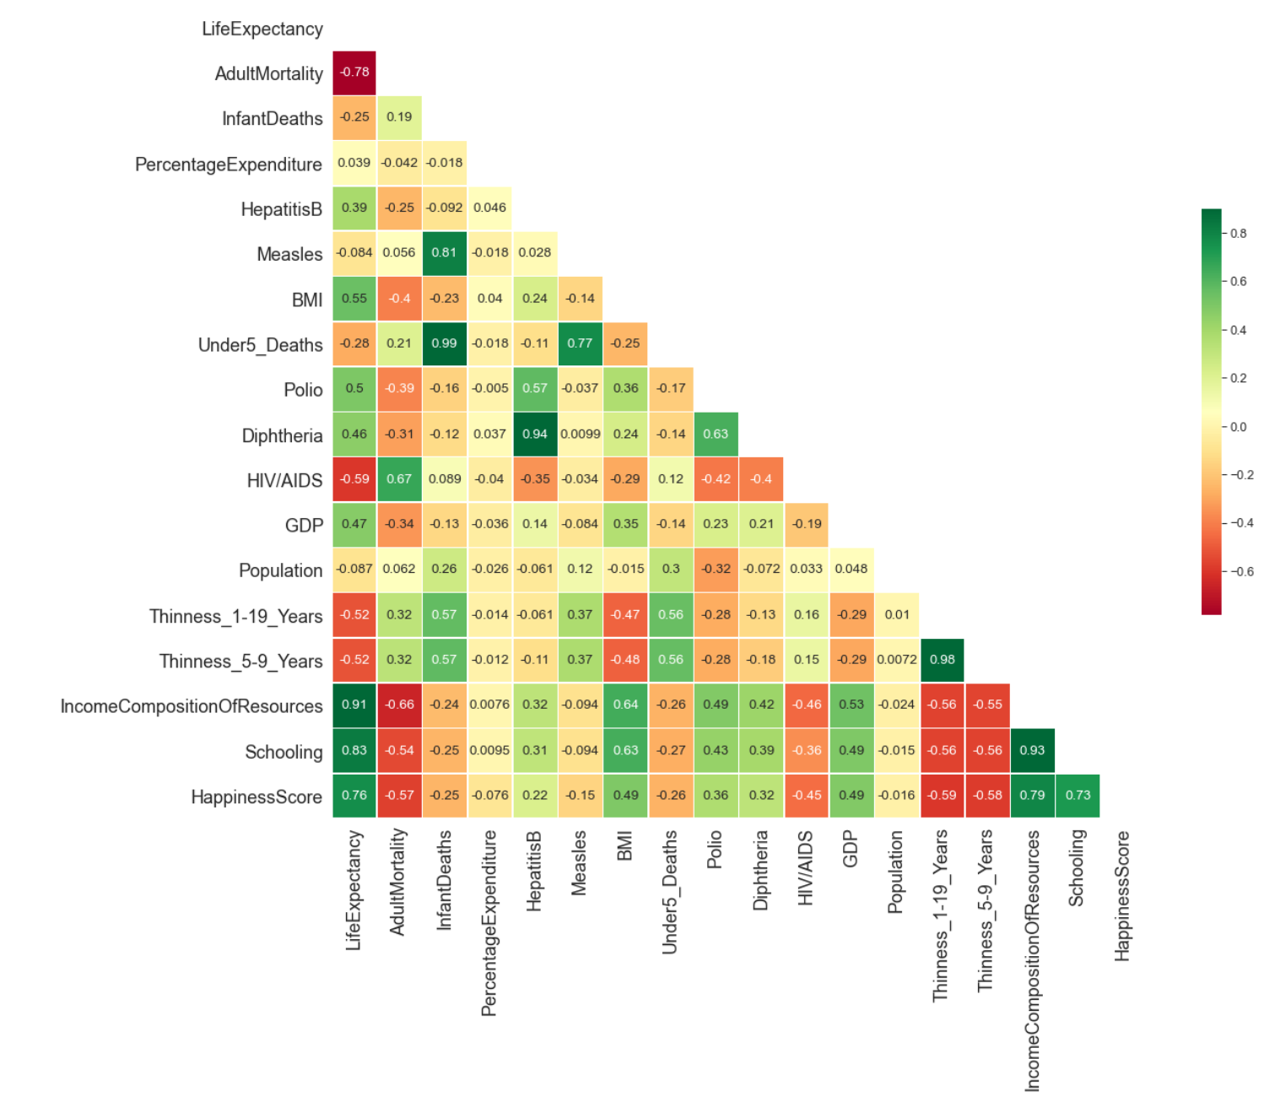
Correlation between variables

Slide 6
Pipeline
Data
Acquisition + Business Question
Exploring & Cleaning
Deliver
Hypothesis
Calculate & Visualize

Slide 7
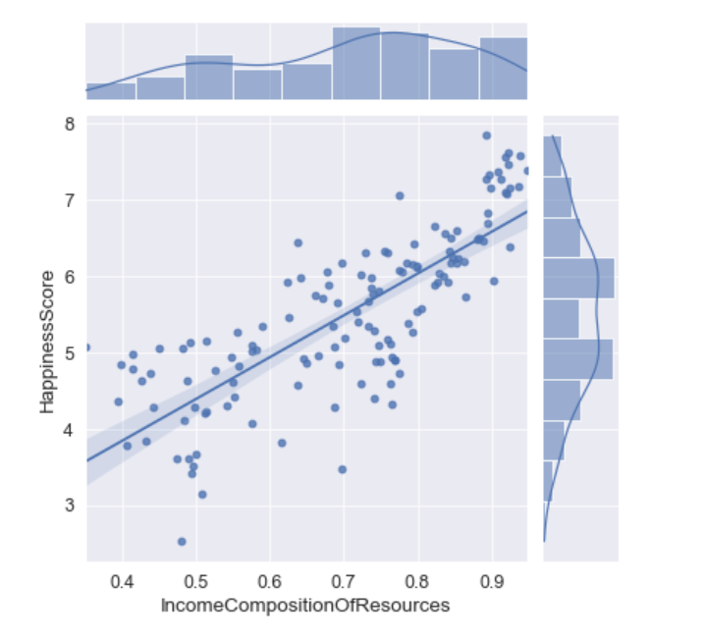
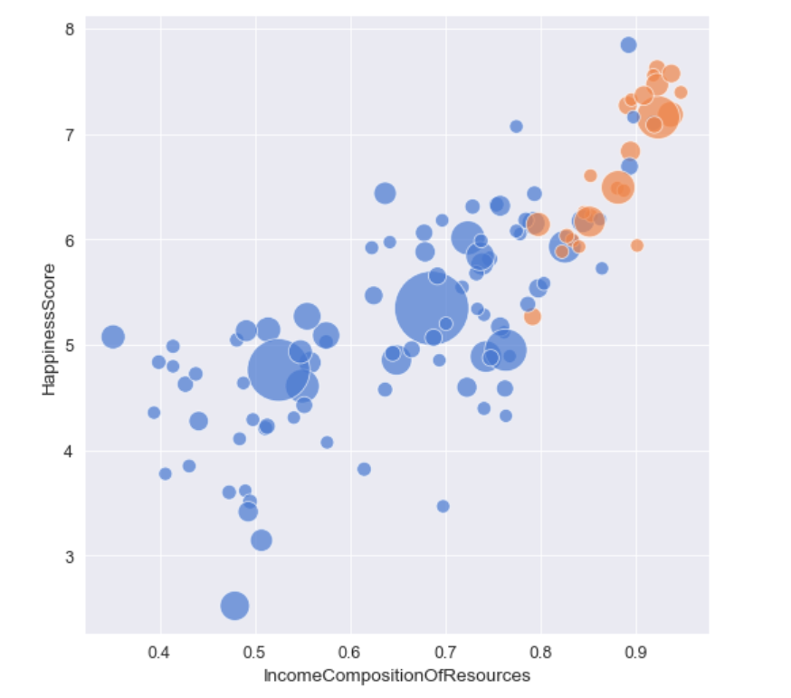

Visualizations
Income Composition of Resources (ICOR) Vs Happiness Score
Size of the markers = Population

Slide 8
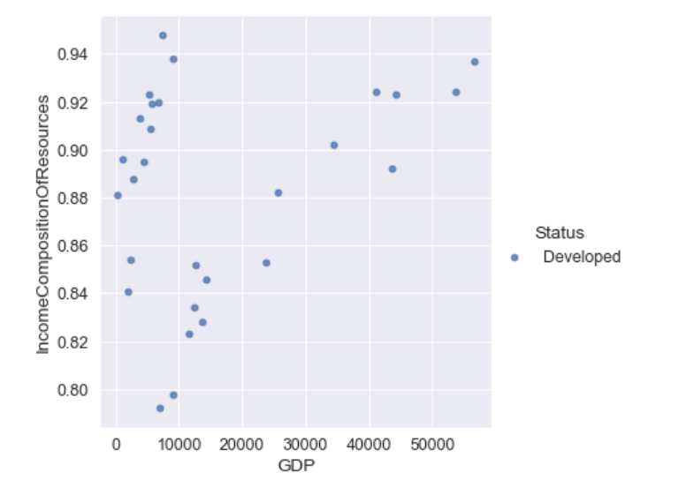
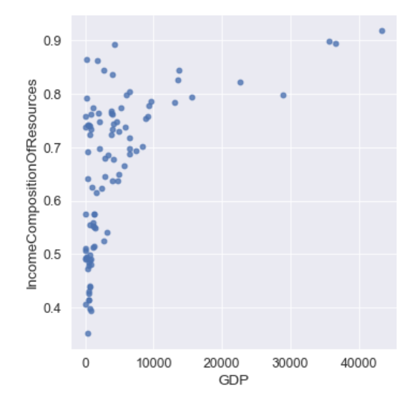
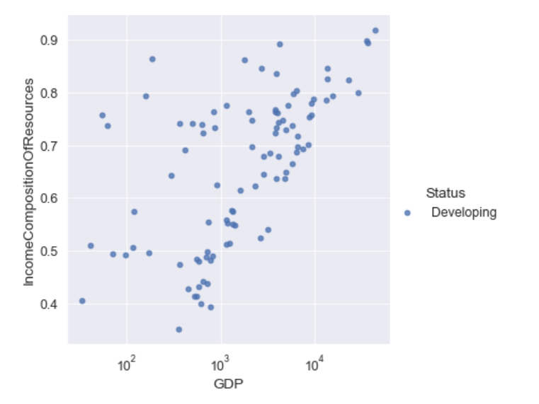
Visualizations cont.
GDP Vs Income Composition of Resources

Slide 9
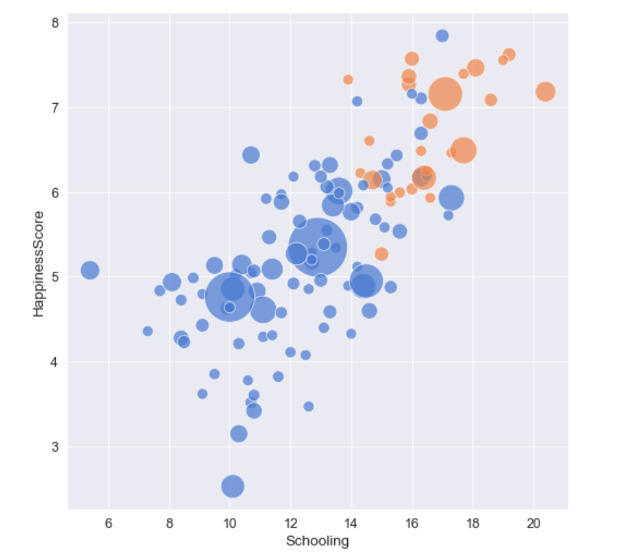
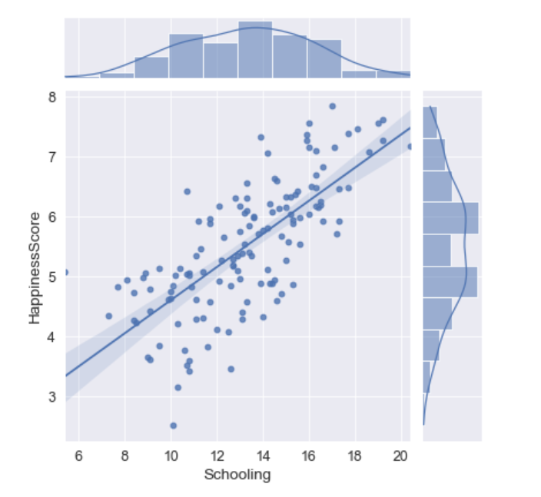
Visualizations cont.
Schooling Vs Happiness Score
Size of the markers = Population

Slide 10
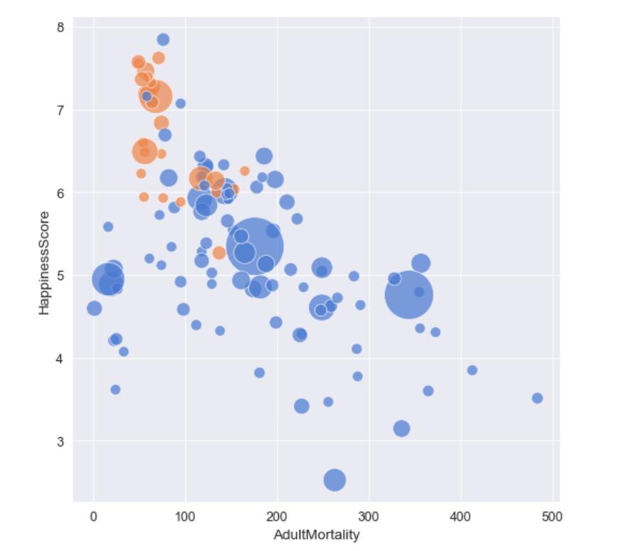
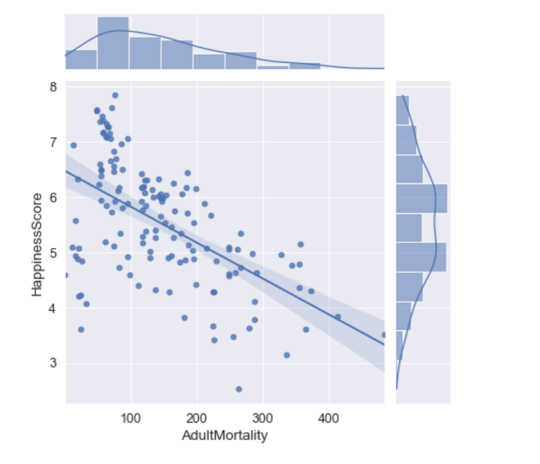
Visualizations cont.
Adult Mortality Vs Happiness Score

Slide 11
Hypothesis
H0 – There is no difference between a country with higher ICOR vs lower ICOR
H1 – There is a difference between a country with higher ICOR vs lower ICOR
Significance level: 5%
ICOR: Income Composition of Resources

Slide 12
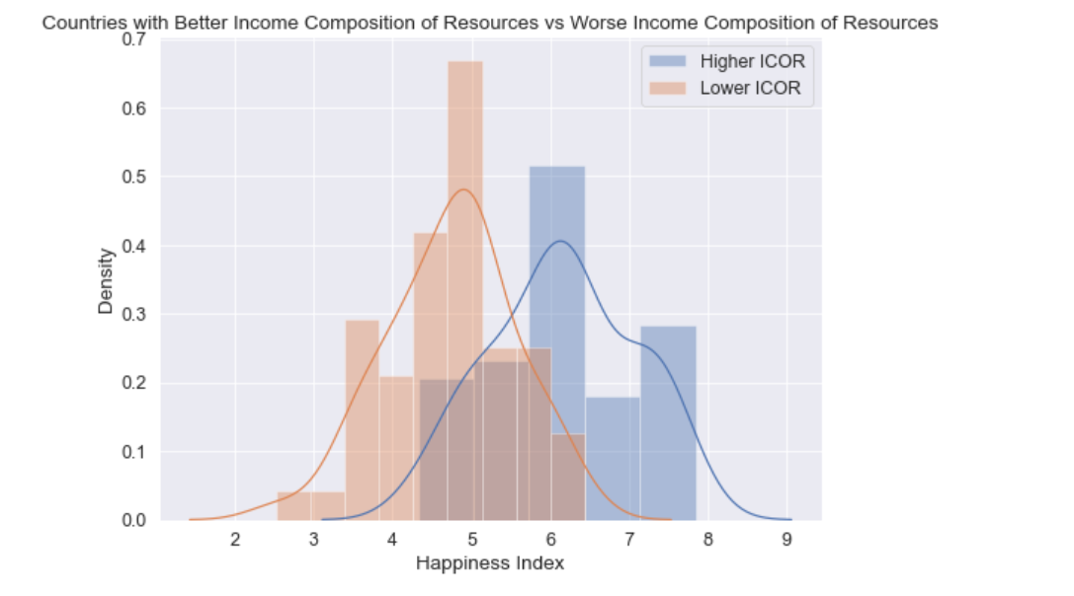
Hypothesis Testing
p = 7.447942670245852e-15
We reject our null hypothesis
There is a difference between a country with higher ICOR vs lower ICOR

Slide 13
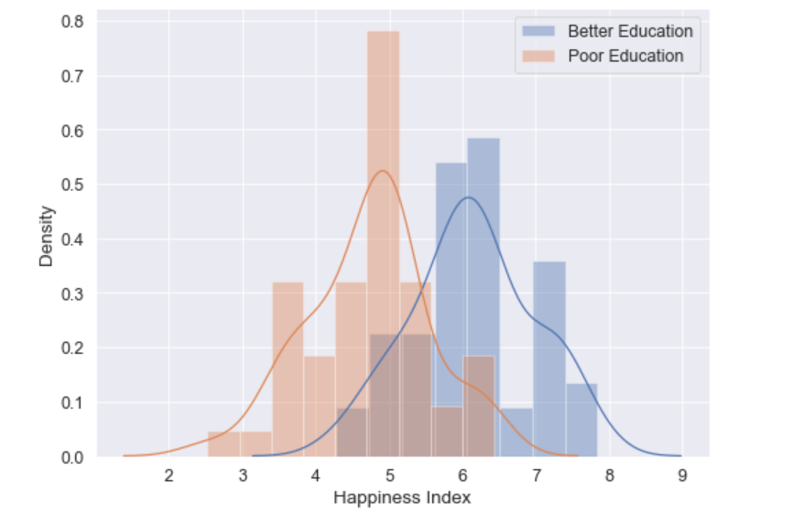
Hypothesis Testing
p = 4.924888750836091e-12
We reject our null hypothesis
There is a difference between a country with better education vs worse education

Slide 14
Conclusion
There are more economic and social factors that affect happiness including – income utilization, education & healthcare facilities.

Slide 15
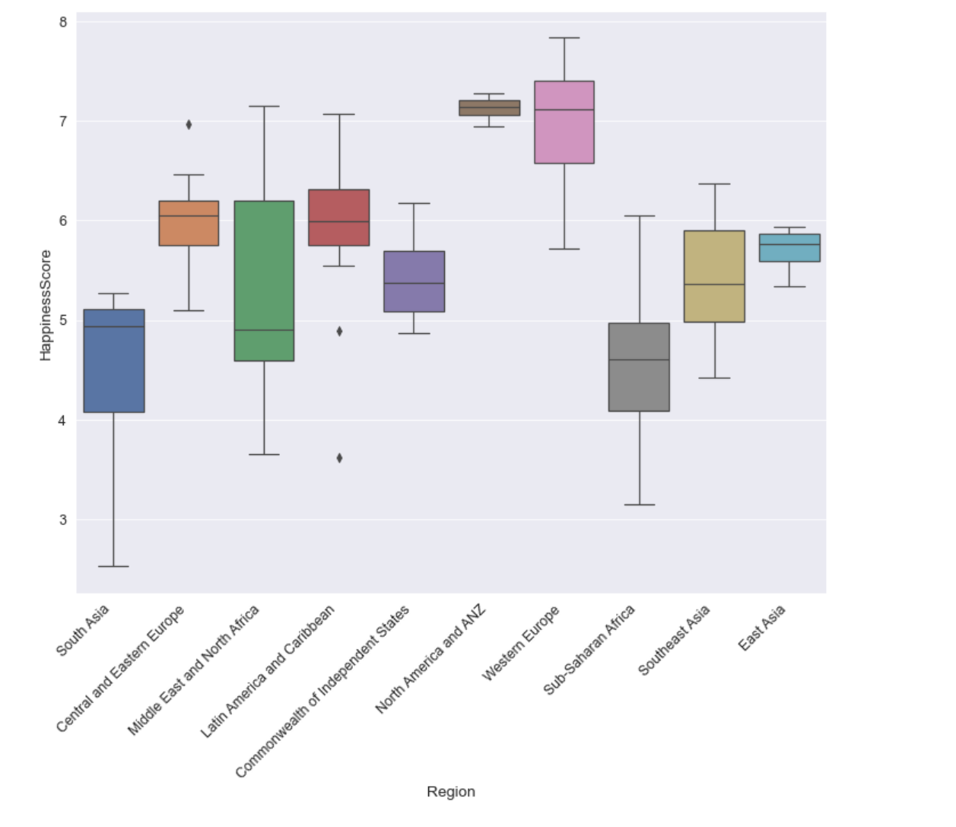
Further Improvements
Further Breakdowns
More Social Factors
Analyze Historical Data

Slide 16
Thank You!

